Slide 1
Plan, Schedule, Test Community Portal
Module Project
Module: NICF Capstone Project using Java
Course: NICF Advanced Certificate in Software & Applications (Development & Deployment)
Start Date : 29 September 2022
End Date : 14 October 2022
Submission Date : 14 October 2022
Learner Name : Ida Bagus Ketut Yoghantara
Enrollment ID : BDSE04-0322
Presentation Date :

Slide 2
Contents
Document History
Version Number | Effective Date of release | Summary of Included Changes | Author
1 | 4th March 2016 | First Edition | Satya CVS
2 | 23rd Jul 2018 | Changed for Module 6 | Shrinivas K R

Slide 3
Contents
Contents
S. No. | Description
01 | Different Types of Testing
02 | How Different Testing Helps
03 | Tests Selected
04 | Test Schedule
05 | Test Results
06 | Testing Tools
07 | Project Milestone & Tasks
08 | Milestone Feedback & Action Taken
09 | Modifications Made Based on Feedback
10 | Project Results
11 | Proposed Improvements

Slide 4
1. Different Types of Testing
Functional Testing
Unit Test Unit tests are very low level and close to the source of an application. They consist in testing individual methods and functions of the classes, components, or modules used by your software. Unit tests are generally quite cheap to automate and can run very quickly by a continuous integration server.
Integration Test Integration tests verify that different modules or services used by your application work well together. For example, it can be testing the interaction with the database or making sure that microservices work together as expected.
User Acceptance Testing Acceptance tests are formal tests that verify if a system satisfies business requirements. They require the entire application to be running while testing and focus on replicating user behaviors.

Slide 5
1. Different Types of Testing
Non-Functional Testing
Cross-browser testing Cross-browser testing, also called browser testing, is a quality assurance (QA) process that checks whether a web-based application, site or page function as intended for end users across multiple browsers and devices.
Performance Testing Performance tests evaluate how a system performs under a particular workload. These tests help to measure the reliability, speed, scalability, and responsiveness of an application.
Load Testing A load test is a type of performance test that checks how systems function under a heavy number of concurrent virtual users performing transactions over a certain period of time.

Slide 6
2. How Different Test Helps
Functional Testing
Unit Testing 1. Helps developer write better code 2. It helps developer to catch bugs earlier 3. It makes the code more easy to refactor
User Acceptance Testing 1. Keeping ongoing maintenance costs as low as possible 2. Increase end-user happiness 3. Increasing software robustness and usability
Integration Testing 1. Integration testing for different modules at the same time is easy. 2. It can be used in the early as well as later stages of the testing process. 3. It improves test coverage and provides an additional level of reliability.

Slide 7
2. How Different Test Helps
Non-Functional Testing
Cross Browser Testing 1. Reduction of repetitive work 2. Greater consistency and repeatability 3. Ease of access to information about tests or testing
Performance Testing 1. Measure the speed, accuracy and stability of software 2. Performance testing allows you to keep your users happy 3. Improve optimization and load capability
Load Testing 1. Minimizes the cost of failure for organizations. 2. Improves software scalability. 3. Reduces the risk for system downtime.

Slide 8
3. Tests Selected
List the testing methods selected to test the project
Functional Testing
1. Unit Testing
2. User Acceptance Testing (UAT)
Non-Functional Testing
1. Cross Browser Testing

Slide 9
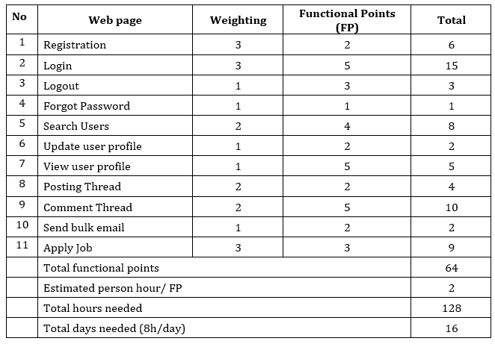
4. Test Schedule
Scheduling:

Slide 10
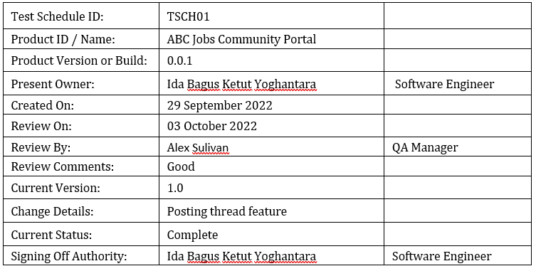
4. Test Schedule
Test Schedule:

Slide 11
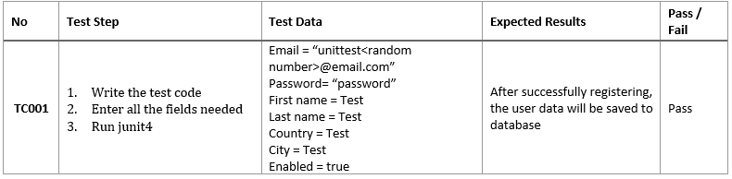
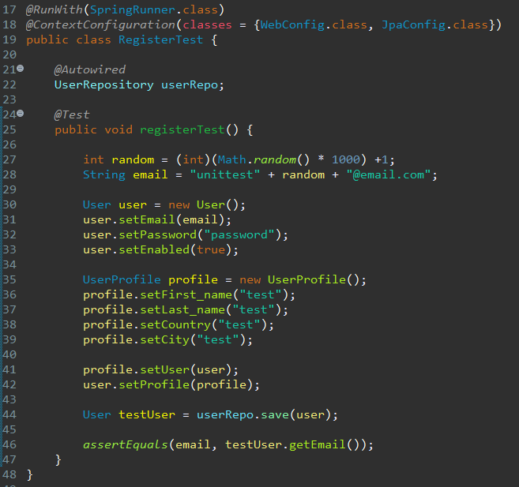
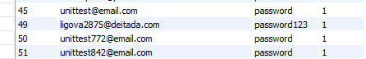
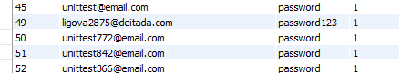
5. Test Results
Unit Testing
Database before test:
Database after test:

Slide 12
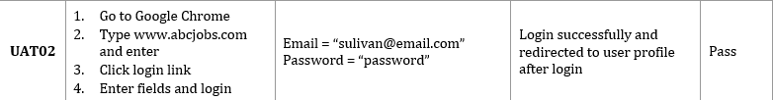
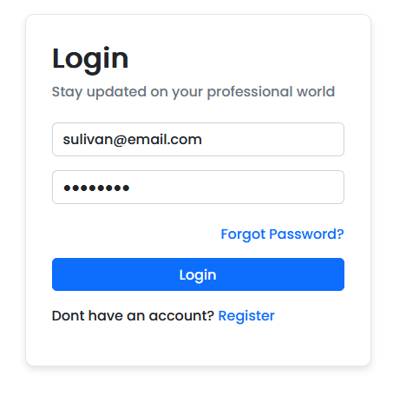
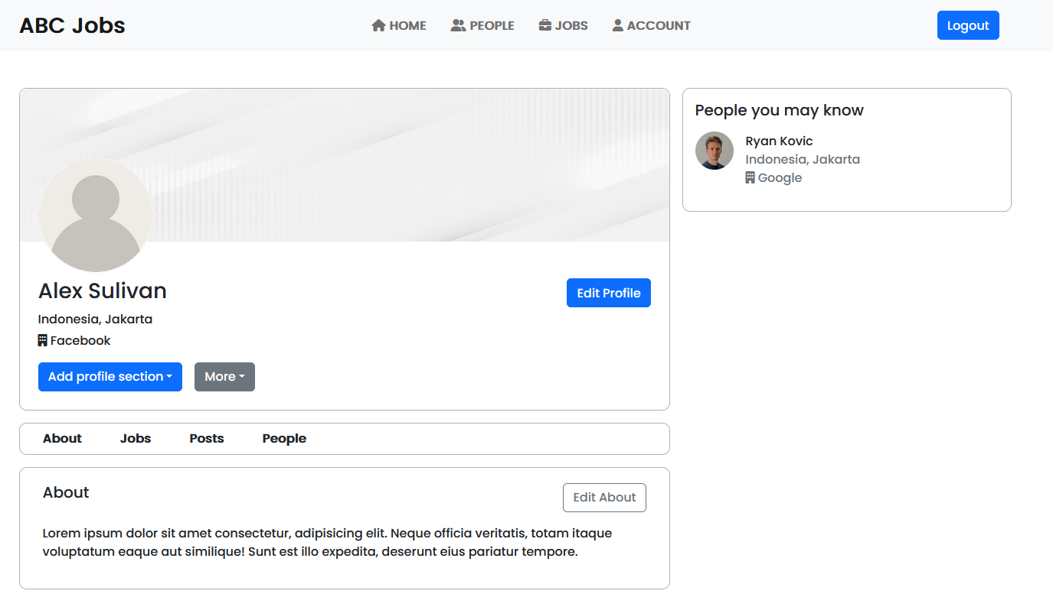
5. Test Results
User Acceptance Testing

Slide 13
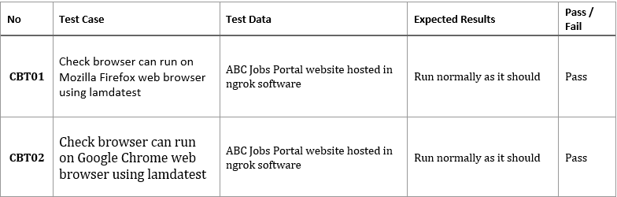

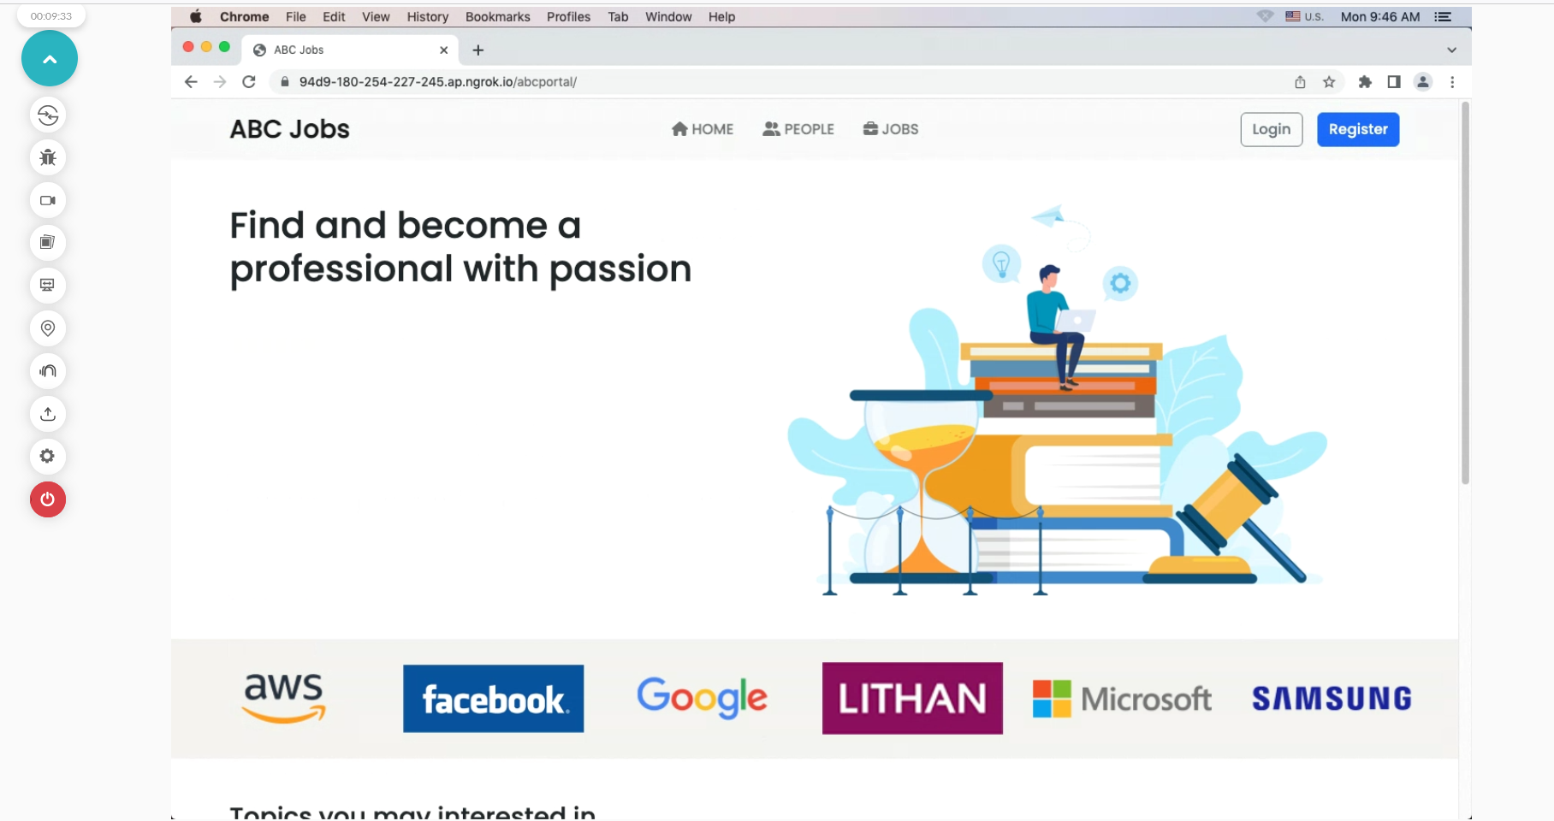
5. Test Results
Cross Browser Testing
CBT01
CBT02

Slide 14
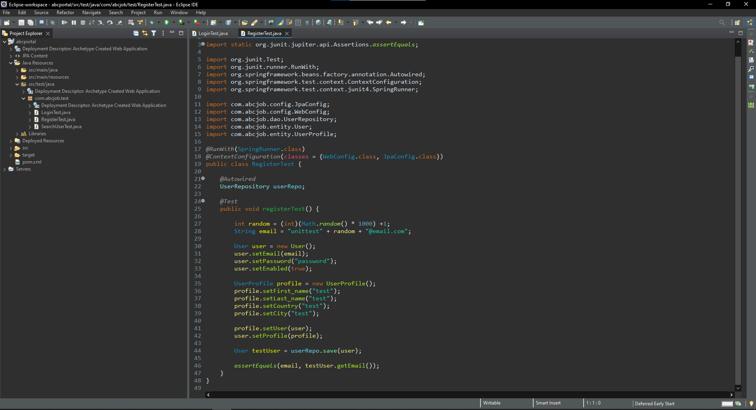
6. Testing Tools
Testing Tools
Lamdatest.com
Eclipse IDE + JUnit4

Slide 15
7. Project Milestones & Tasks
Project Task ID | Project Task Description | Project Milestone ID
1 | Analyze and suggest choice of Test Methods | 1
2 | Schedule the Test Optimally | 1
3 | Develop the Phase Test Plan | 1
5 | Develop Test Cases & Scripts | 2
6 | Execute the Tests & Document the results | 3

Slide 16
8. Milestone Feedback & Action taken
Project Milestone ID | Milestone Feedback received from Tutor / Learning Facilitator | Action Taken (Yes / No)
1 | Adding scheduling calculation in project presentation | Yes
2 | Test the DAO layer directly | Yes

Slide 17
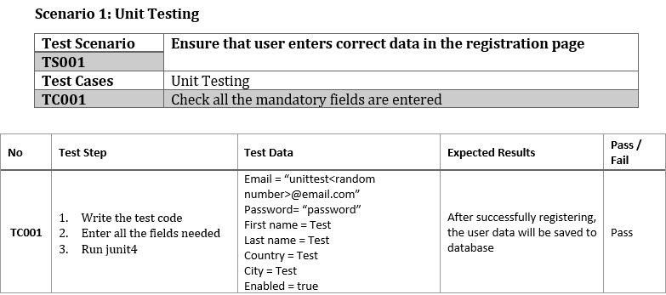

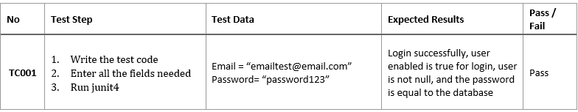
10. Project Results

Slide 18
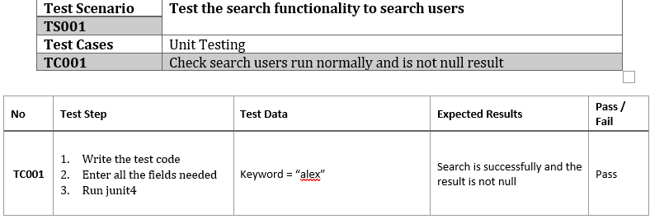
10. Project Results

Slide 19
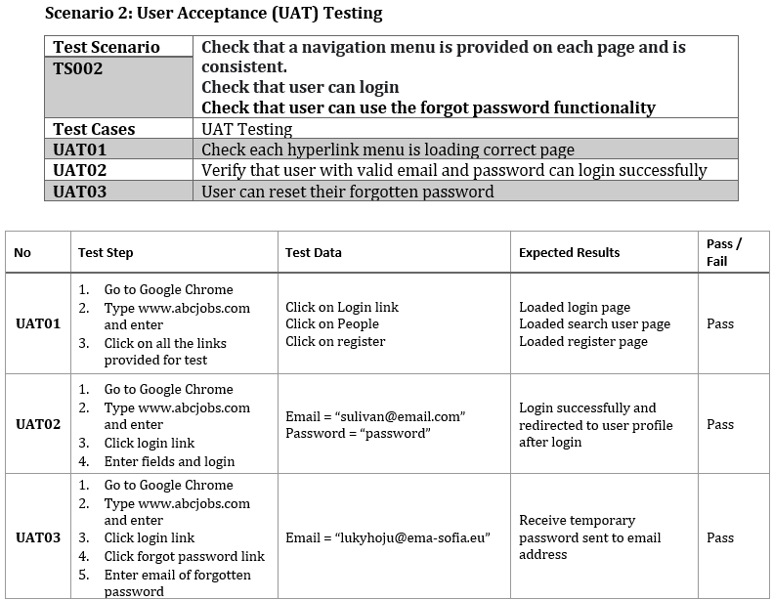
10. Project Results

Slide 20
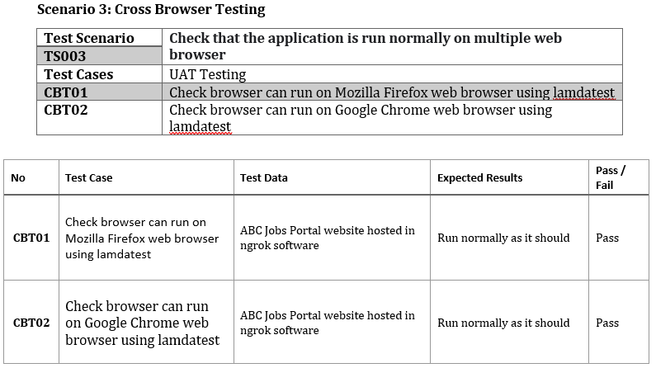
10. Project Results

Slide 21
11. Proposed Improvements
List of Improvements
Making better test script
Learn more about testing software application

